Slide 1
Moving JBoss Applications to ECS
Replatforming II
Sergio Castiñeyras Startups Solution Architect (Latin Americas)
Notes:
Welcome guests, thank them for joining this session, short intro to my background, explain what this session is about

Slide 2
Table of contents
Migration strategies/paths
Replatforming Benefits
AWS App2Container
Smaller changes are better
Refactoring the Dockerfile
AWS Copilot to the rescue

Slide 3
Migration paths

Slide 4




Migration paths based on desired business outcomes
Timeline driven / Data center exit
Sustain
Rehost
(Lift & Shift)
Improve operating model & cost
Replatform
(Lift & Tinker)
Determine
Optimize
Discover
Repurchase
(Drop & Shop)
Strategic Innovation
Retain
Grow
Refactor
(Cloud-native)
Retire
Notes:
Briefly explain the 6 R’s on this slide
Refactor/re-architect – Move an application and modify its architecture by taking full advantage of cloud-native features to improve agility, performance, and scalability. This typically involves porting the operating system and database. Example: Migrate your on-premises Oracle database to the Amazon Aurora PostgreSQL-Compatible Edition.
Replatform (lift and reshape) – Move an application to the cloud, and introduce some level of optimization to take advantage of cloud capabilities. Example: Migrate your on-premises Oracle database to Amazon Relational Database Service (Amazon RDS) for Oracle in the AWS Cloud.
Repurchase (drop and shop) – Switch to a different product, typically by moving from a traditional license to a SaaS model. Example: Migrate your customer relationship management (CRM) system to Salesforce.com.
Rehost (lift and shift) – Move an application to the cloud without making any changes to take advantage of cloud capabilities. Example: Migrate your on-premises Oracle database to Oracle on an EC2 instance in the AWS Cloud.
Retain (revisit) – Keep applications in your source environment. These might include applications that require major refactoring, and you want to postpone that work until a later time, and legacy applications that you want to retain, because there’s no business justification for migrating them.
Retire – Decommission or remove applications that are no longer needed in your source environment.

Slide 5
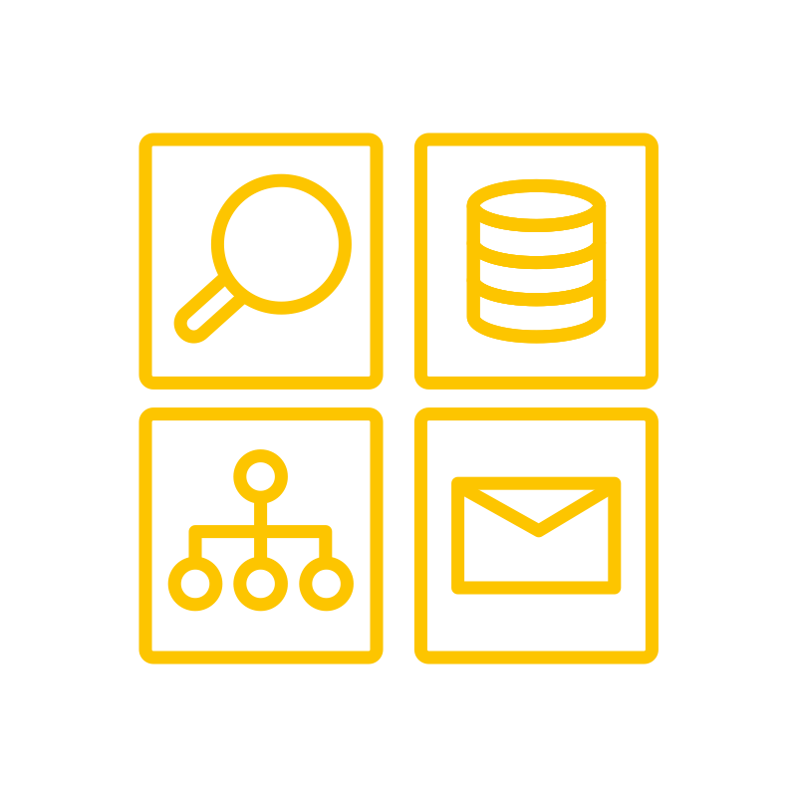
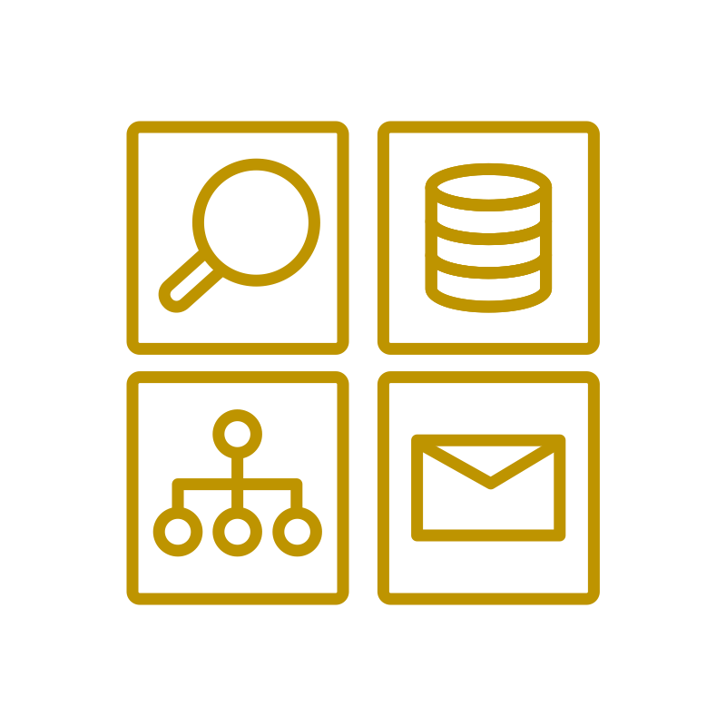




Modernization
Avoiding the stall
Re-architect
Re-platform
Re-host
Repurchase
Retain
New capabilities
Retire
Value to business
Notes:
We consider technology modernization to be the refactoring, re-platforming, or rearchitecting of legacy enterprise technology portfolios by combining modern infrastructure, architecture, engineering and organizational patterns. While customers can realize some cost-reduction, security improvements, and scalability benefits by applying these modern capabilities individually, it is the combination of efforts across all four that maximizes technical resiliency, engineering efficiency, and business agility.

Slide 6
Modernization
Why replatform?
Let cloud be cloud
Start small towards your end goals
Find different approaches to decouple/strangle your monolith
Leverage managed services
Notes:
Let cloud be cloud: Don’t replicate your on premises environment in the cloud. Lift and shift is great when you are short on time, but you will be dragging the technical debt as well. As developers, technical debt is not our friend.
Start small, gradually moving towards your end goals, containerize your app first to make it portable, then leverage features from the new platform as your tools to modernize
Be creative and find new ways to modernize your monolith, as developers, we can find new ways on how you handle credentials, how you deploy changes, how you govern external configuration properties, database connections, how to monitor your server, how you orchestrate the workload, once your workload is running on aws, several services can help, for example, Parameter Store.

Slide 7
Replatforming steps
Analyze the application
Model the application to captures its components
Shape a selection of the components to use managed services
Deploy the modelled application
Test the deployed application
Transition
Notes:
. Analyse the application, understanding its components, dependencies, operational needs and “normal” behaviour including known problems.
. Model the application using a blueprinting technology that captures the components, their configurations and integrations with each other.
. Leverage the AWS Well Architected Framework as part of the migration, which is a great help to make sure the application is aligned with best practices such as security, cost and operations: what is possible/aligned now, and what can be done later in the cloud?
. Shape a limited selection of the components to leverage cloud services such as AWS Load Balancer and Relational Database Services, as well as reducing potential issues by replacing brittle scripts by more automation or managed services.
. Deploy the modelled application including data migration (usually from a test system) to an AWS account.
. Test the deployed application, make adjustments.
. Transition

Slide 8
Choose target platform
Amazon Elastic Container Service
Amazon Elastic Kubernetes Service
AWS Elastic Beanstalk
AWS AppRunner
AWS Lambda

Slide 9
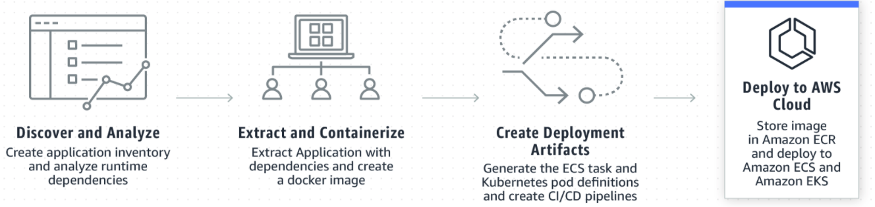
AWS App2Container
Migrate Jboss to ECS, fast.
Notes:
App2Container (A2C) is a command line tool to help you lift and shift .NET and Java applications that run in your on-premises data centers or on virtual machines, so that they run in containers that are managed by Amazon ECS or Amazon EKS
Moving legacy applications to containers is often the starting point toward application modernization. There are many benefits to containerization:
Reduces operational overhead and infrastructure costs.
Increases development and deployment agility.
Standardizes build and deployment processes across an organization.
Linux, Tomcat, Jboos,
Windows, IIS 7.5, .NET

Slide 10



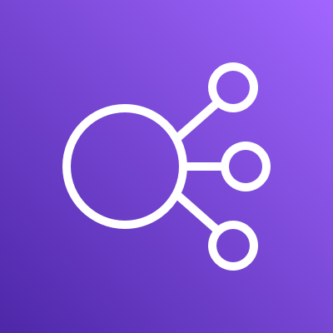





Replatforming the architecture
After
Before
AWS Cloud
AWS Cloud
Amazon Elastic Container Service
Office building
Elastic Load Balancing
Task
Container
JBoss
Server
Amazon S3
CloudFormation
Amazon Elastic Container Registry

Slide 11
AWS App2Container
Step 1 - Discover & Analyze
Notes:
In this slide, we will switch to a shared screen, where I will show how to use App2Container to migrate the Jboss server to ECS
We will dive deep on the artifacts generated by the tools, and the customizations required to make Jboss work on ECS (ports, health check, timeouts, etc)
Discover And Analyze
Creates an inventory list for the application server that identifies all running ASP.NET (Windows) and Java applications (Linux) that are candidates to containerize.
Analyzes the run-time dependencies of supported applications that are running, including cooperating processes and network port dependencies.

Slide 12
AWS App2Container
Step 2 - Extract and Containerize
Given Dockerfile:
Notes:
Extract and Containerize
Extracts application artifacts for containerization and generates a Dockerfile.
Initiates builds for the application container.

Slide 13
AWS App2Container
Step 3- Create Deployment Artifacts
Notes:
Create Deployment Artifacts
Generates the artifacts needed to deploy your application container in AWS. Creates an Amazon ECR repository and copies there the application container image you have created. Creates an ECS Task Definition and registers it with ECS.
Builds an AWS CloudFormation template to configure required compute, network, and security infrastructure to deploy containers using Amazon ECS or Amazon EKS.

Slide 14
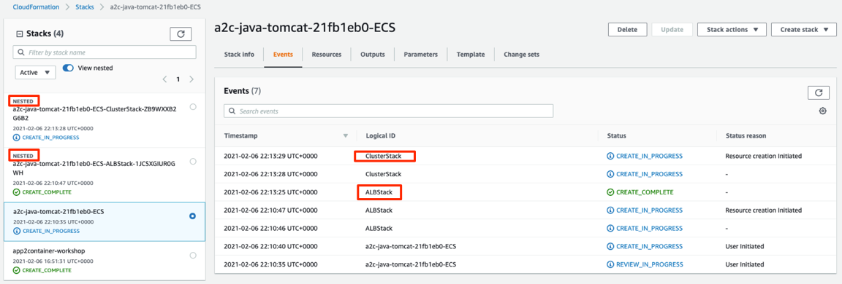
AWS App2Container
Step 4 - Deploy to AWS Cloud
Notes:
Deploy to AWS Cloud
Deploys the containers on Amazon ECS or Amazon EKS by executing the prepared CloudFormation Stack

Slide 15
App2Container Artifacts
Packing the monolith
Notes:
We can see app2container has scanned the host, found the operative system, system config files, libraries, and application server running, and extracted everything into a package that can be executed as a Dockerfile using a tar file that contains everything. What it will do is download a fresh copy of ubuntu, install java on it, add all the environment variables and same configuration that the original host had, and execute the java command that was executed on our onpremises server to start the same version of jbosss. Now, this is great as it saved a lot of time, but this is still considered a monolith.

Slide 16
There is no economy of scale in software
Smaller changes are better
Notes:
Being a monolith means that any changes in code or configuration will need a full deploy of the entire stack, essentially defeating the purpose of agile methodology for testing small changes frequently, that are easy to experiment and revert. So let’s see a different approach

Slide 17
Easier to
tell if it breaks
Change one small thing at a time
roll back to previous version
Easier to
measure time to value
Easier to
Notes:
What if we can do the same replatform, but decoupling the application service from the internal components that are being deployed in it? Imagine being able to deploy individual war files independently to test changes faster, allowing each of them to be versioned on separate repositories, and deployed by specific pipelines

Slide 18
New code from new feature
Incrementally change system with many small safe updates
Turn on features for testing and when it works—for everyone

Slide 19
Less risk
Faster problem detection
Faster repair
Less work in progress
Less time merging changes
Happier developers
Faster flow
Small changes

Slide 20
Dockerfile Refactor
Step 1 - Use JBoss base
Notes:
Instead of using the tar compressed file, use the jboss base image to simplify, and add the deployed wars inside the app server as subdirectories.

Slide 21

Dockerfile Refactor
Step 2 - Use versioned services
ECR
Notes:
https://github.com/jboss-dockerfiles
step 1: Add a dockerfile to each service root directory to dockerize them individually, then use the COPY command to get them from ECR

Slide 22
AWS Copilot
Build, release, and operate production ready containerized applications on Amazon ECS
Notes:
In this slide, we will switch to a shared screen, where I will show how to use Copilot to migrate the same Jboss server step by step, but this time it will decouple each war file within the jboss webapps to run them independently, and also show how the tool creates a deployment pipeline for each artifact.
AWS Copilot is an open source command line interface that makes it easy for developers to build, release, and operate production ready containerized applications on Amazon ECS and AWS Fargate.
Run a single command to quickly get started with a containerized application using best practices on AWS from a Dockerfile.
Instead of modeling individual resources, Copilot provides common cloud architectures: Load Balanced Web Service, Backend Service, Scheduled Job and generates the necessary infrastructure from that. Focus your time on writing business logic instead of connecting AWS resources.
No need to worry about gluing Copilot commands in a script to create an automated release process. Copilot provides commands to create multiple deployment environments in separate AWS accounts and regions, as well as creating an AWS CodePipeline pipeline to build your container images, deploy your services, and run automated tests.
The Copilot CLI is a tool for developers to build, release, and operate production-ready containerized applications on Amazon ECS and AWS Fargate. From getting started, pushing to staging, and releasing to production, Copilot can help manage the entire lifecycle of your application development.

Slide 23
Copilot Pipelines
Git Repo Service 1
Dockerfile
buildspec.yml
pom.xml
pipeline.yml
push
pull
pull
push
Git Repo Service 2
ECR
Dockerfile
buildspec.yml
pom.xml
pipeline.yml

Slide 24
Takeaways
Replatforming can be the easiest strategy to migrate your application, and it can also be the first step to modernize it
Simple tools can be powerful too
Combine different services to help through your roadmap
App2Container: Ideal to transform lift and shift scenarios into quick wins (containerize instead of moving VM’s)
Copilot: build, release and operate production ready containerized applications on AWS, and automate release process with CI/CD pipelines

Slide 25
Additional resources
Migration patterns: https://docs.aws.amazon.com/prescriptive-guidance/latest/patterns/migration-replatform-pattern-list.html
6 Strategies for Migration: https://aws.amazon.com/blogs/enterprise-strategy/6-strategies-for-migrating-applications-to-the-cloud/
Replatforming Applications: https://docs.aws.amazon.com/prescriptive-guidance/latest/migration-replatforming-cots-applications/welcome.html

Slide 26
Q&A

Slide 27



Training and Certification: Migrate with Confidence
Accelerate migration with comprehensive cloud skills enablement
Build confidence and skills for your cloud journey with AWS Training and Certification. Achieve faster, more impactful results throughout every phase of migration—and boldly pursue whatever future you aspire to in the cloud.
Migration digital training
Private Training for your team
Learning Needs Analysis Tool
With self-paced digital training that’s available whenever and wherever it’s needed, individuals and organizations alike can advance toward an agile, productive, cloud- fluent future.
Find digital training »
AWS private classroom training—delivered on site or virtually—does more than effectively and efficiently impart skills that enable cloud innovation. It also helps build team spirit around your organization’s cloud strategy while creating groups of similarly trained peers who can mentor one another.
Learn more »
A comprehensive training strategy can help accelerate and scale cloud adoption. You can identify your organization’s cloud skills gaps with our free self-assessment tool, the AWS Learning Needs Analysis.
Learn more »

Slide 28

Visit the Migration and Modernization Resource Hub for more resources
Dive deeper with these resources, get inspired and learn how to migrate and modernize to accelerate innovation.
Start your migration journey
A leader’s guide to cloud transformation
8 best practices to make cloud migration a success
4 key values for building a migration business case
Migrate SAP workloads simply and efficiently
Migrate to the cloud built for VMware workloads
… and more!
http://bit.ly/migration-aws
Visit resource hub »

Slide 29






Thank You for Attending
ASEAN Online Workshop Series – Migration Edition
A kind reminder to complete the survey at the end of the session.
Let us know what you think of today’s event and how we can improve the event experience for you in the future.
aws-asean-marketing@amazon.com
twitter.com/AWSCloudSEAsia
facebook.com/AmazonWebServices
youtube.com/user/AmazonWebServices
slideshare.net/AmazonWebServices
twitch.tv/aws
Notes:
Thank you for attending! We hope you found the session interesting. We really appreciate your feedback, in order for us to better understand the topics and services you would like to know more about.
Please, DO take the time to fill out our survey that pops up at the end of the session, and let us know what you think and how we can improve the experience for you.

